Slide 1


BUSGY
YOUR'S TRAVEL PARTNER
2022126 AYUSH KUMAR MOURYA
2022127 AYUSH SINGHAL
2022128 AYUSHMAN
2022129 AYUSHMAN PANDEY
2022130 B LEMPUSEN JAMIR

Slide 2
PROBLEM STATEMENT
More than 30 lakh people, which is nearly 14% of Delhi’s population, travelled in DTC and cluster scheme buses
everyday in February 2022.
However, there is no proper mobile application clearly demarcating the routes of various numbered buses. Additionally, there is no way that a person waiting for a DTC bus at a bus stand would get to know the exact location and timing of the next bus owing to the uncertainty due to the traffic of Delhi.

Slide 3
BACKGROUND OF THE PROBLEM / OUR MOTIVATION
We ourselves have travelled in the DTC buses numerous times as it was the primary mode of transportation that enabled us to travel to our coaching institutes. However, waiting for the next bus becomes really frustrating when you're running late and you don't know whether the next bus will come at the bus stand in the next one minute or in the next 10-20 minutes.
Thus we felt the need of a good mobile application that would facilitate the users to check the timings of upcoming buses, find the right bus numbers to travel to a particular destination as well as be able to book tickets online through an integrated payments gateway

Slide 4
SOLUTION/SCOPE
personalised for each user through a quick signup/login process.
It would then provide them the option to use their live location to track the nearest bus stand.
The users will be able to put in their destination and the app would provide the shortest route and the bus numbers which follow that particular route.
Furthermore, the app would be able to show the accurate timings of the upcoming buses using their live locations.
The application would also provide the option of purchasing tickets online using a UPI-based payments gateway, thus avoiding the need of gathering around the conductor for tickets. We strongly believe that if implemented through a thorough application of interaction design principles, this application would prove to be a very simple, effective and usable solution to the chaotic scenario of the Delhi Transport Corporation.

Slide 5
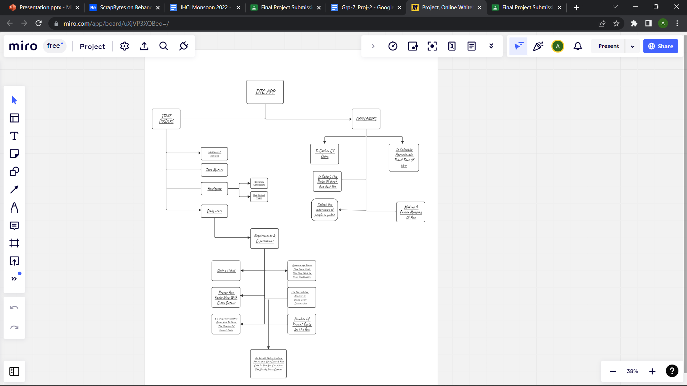

REQUIREMENT GATHERING
link to mind map

Slide 6
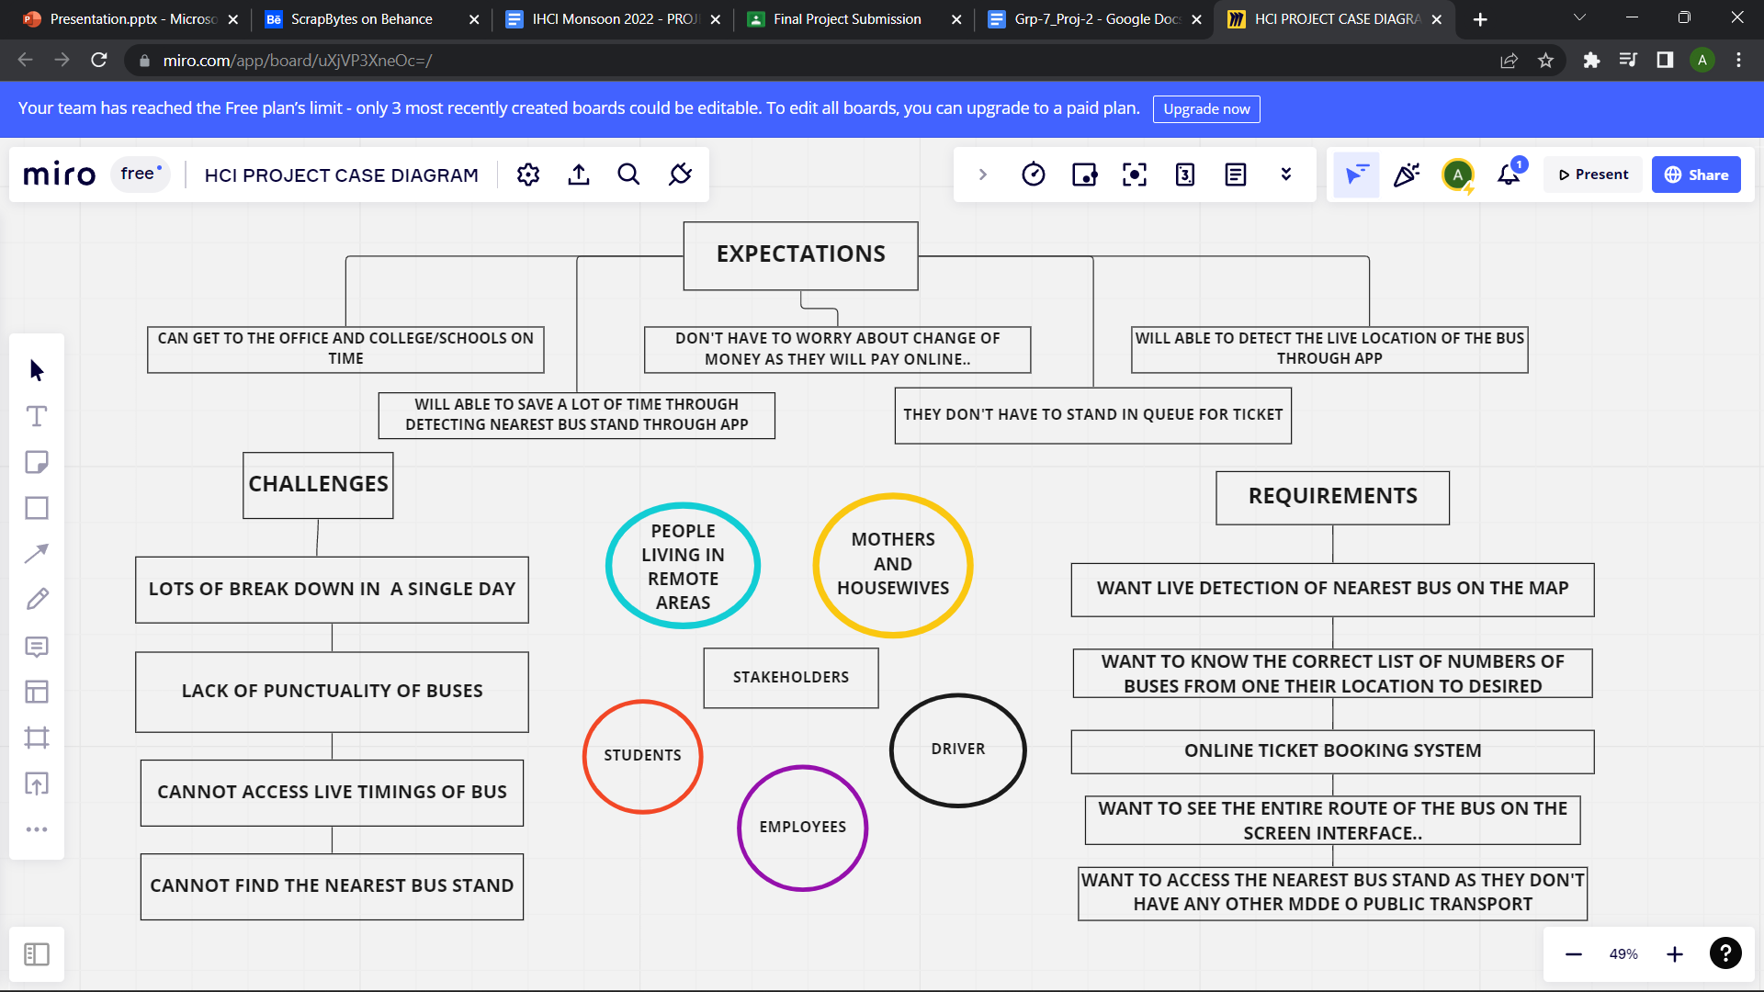
link to case diagram

Slide 7

PERSONAS
Link to personas
Link to personas

Slide 8
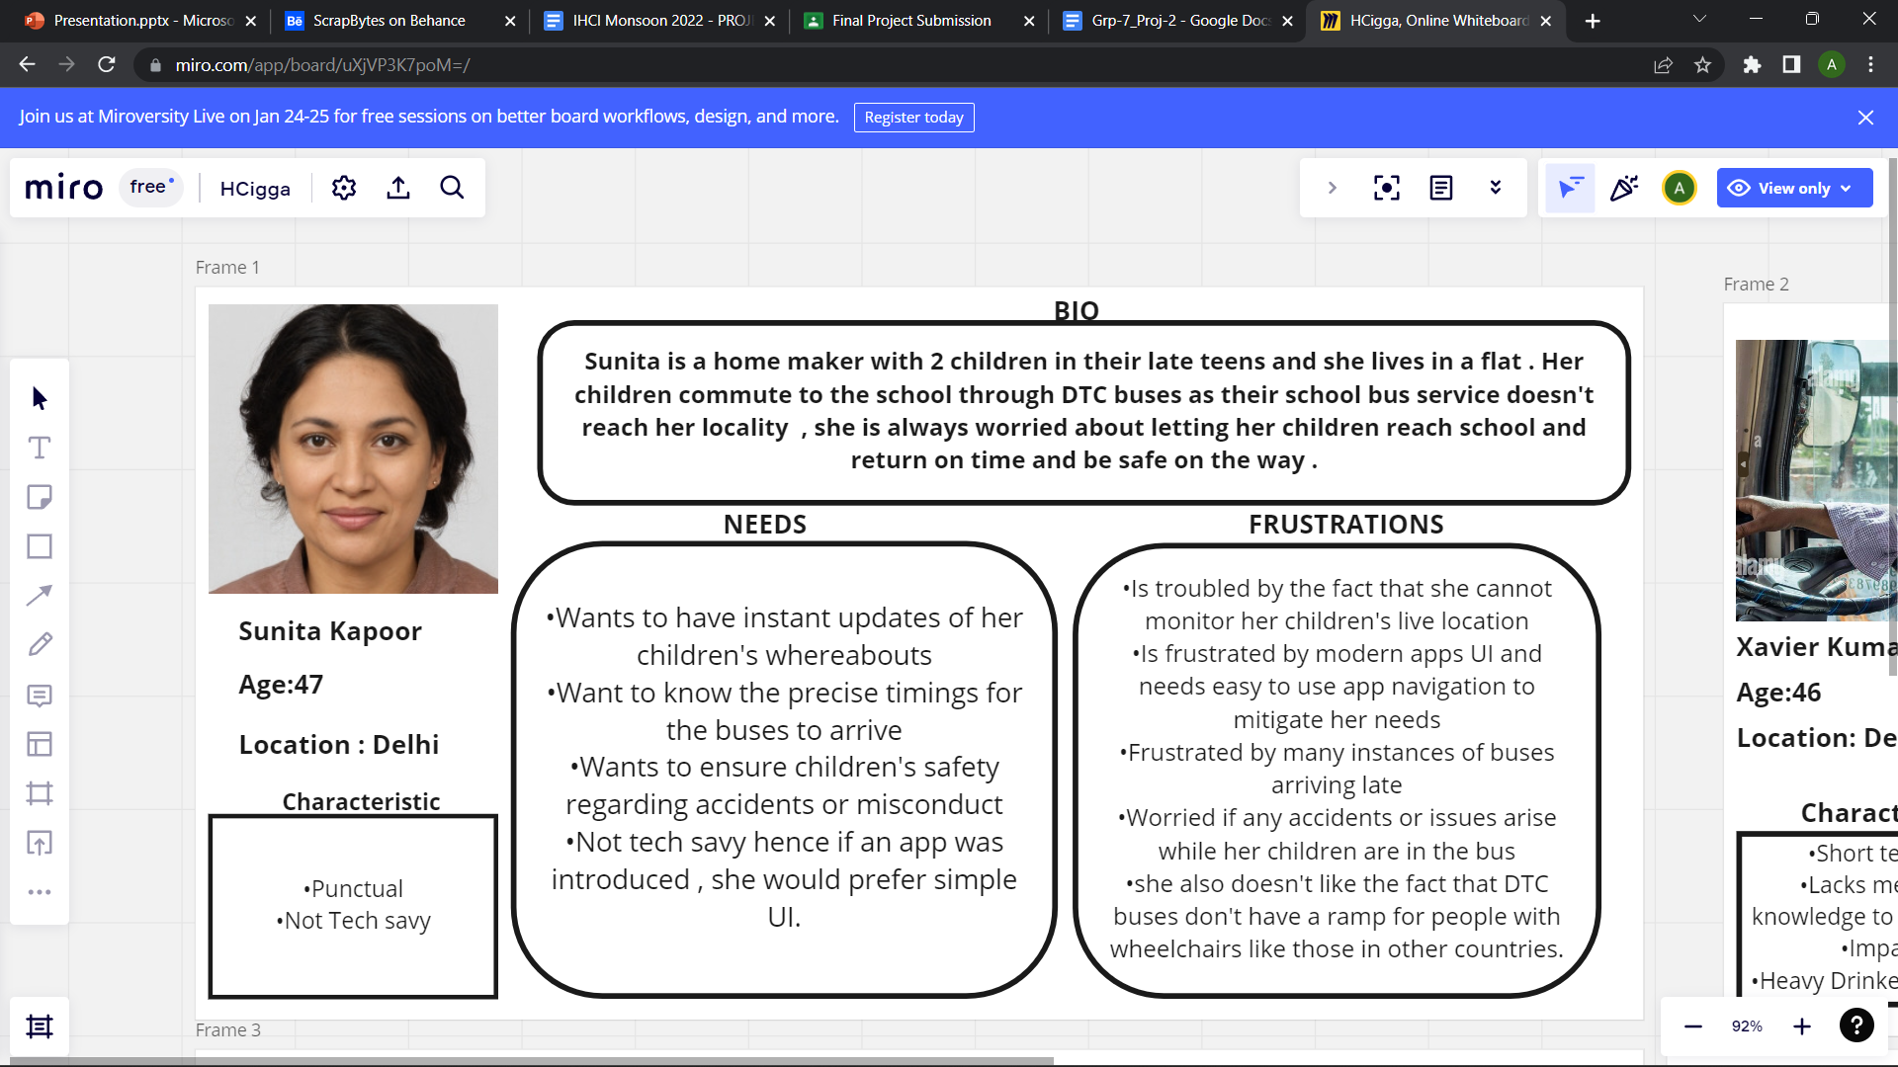

Slide 9
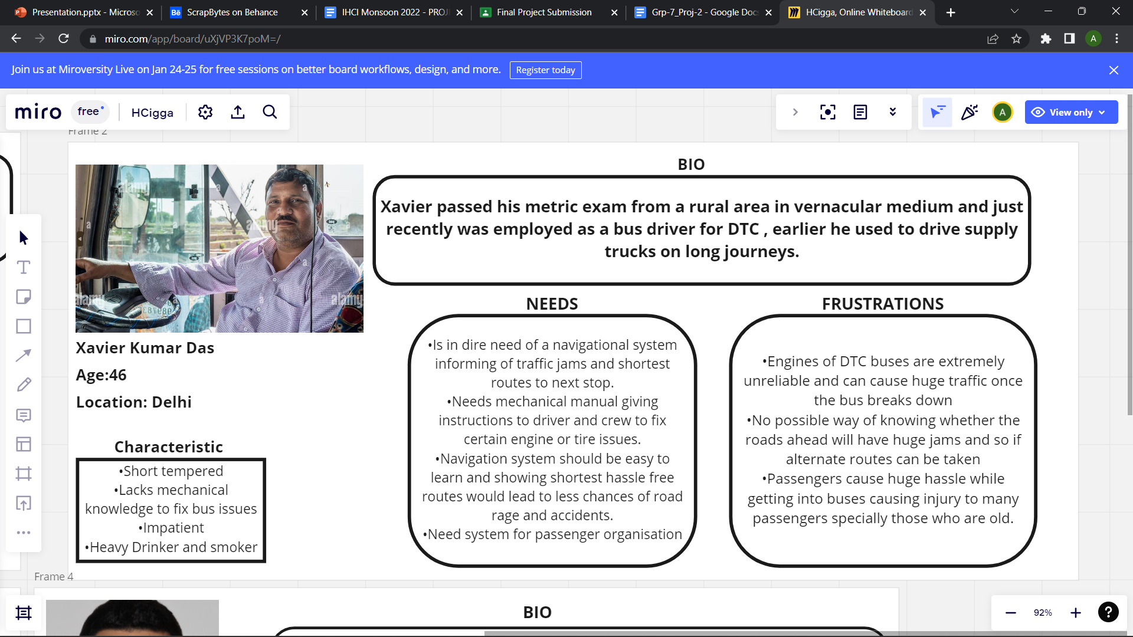

Slide 10
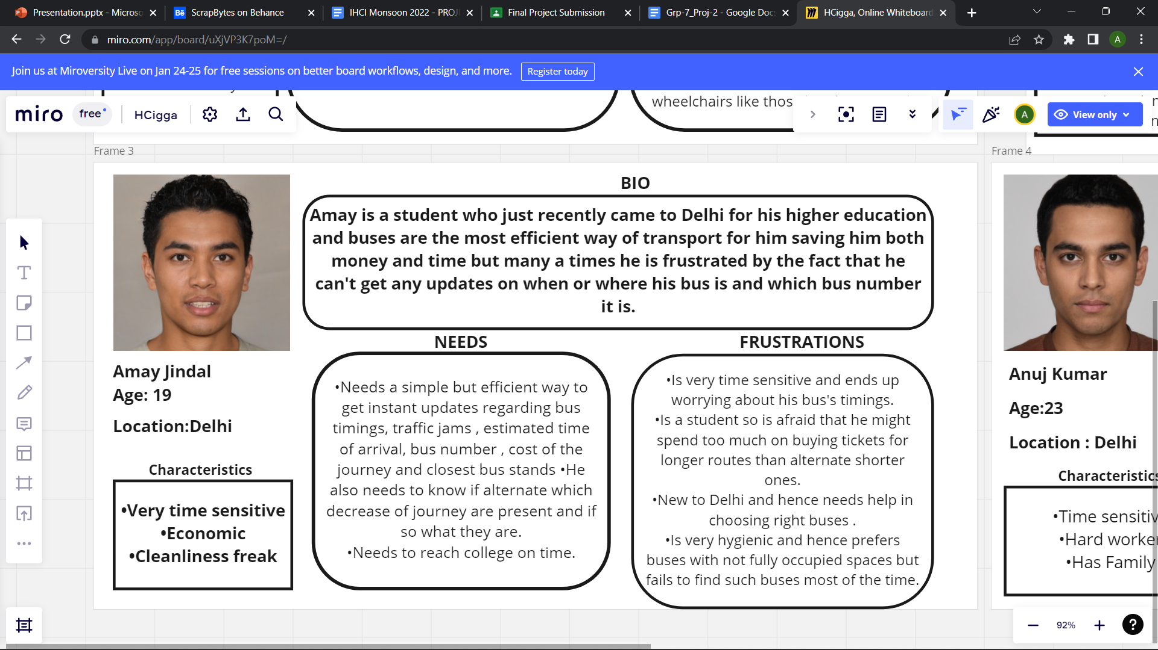

Slide 11
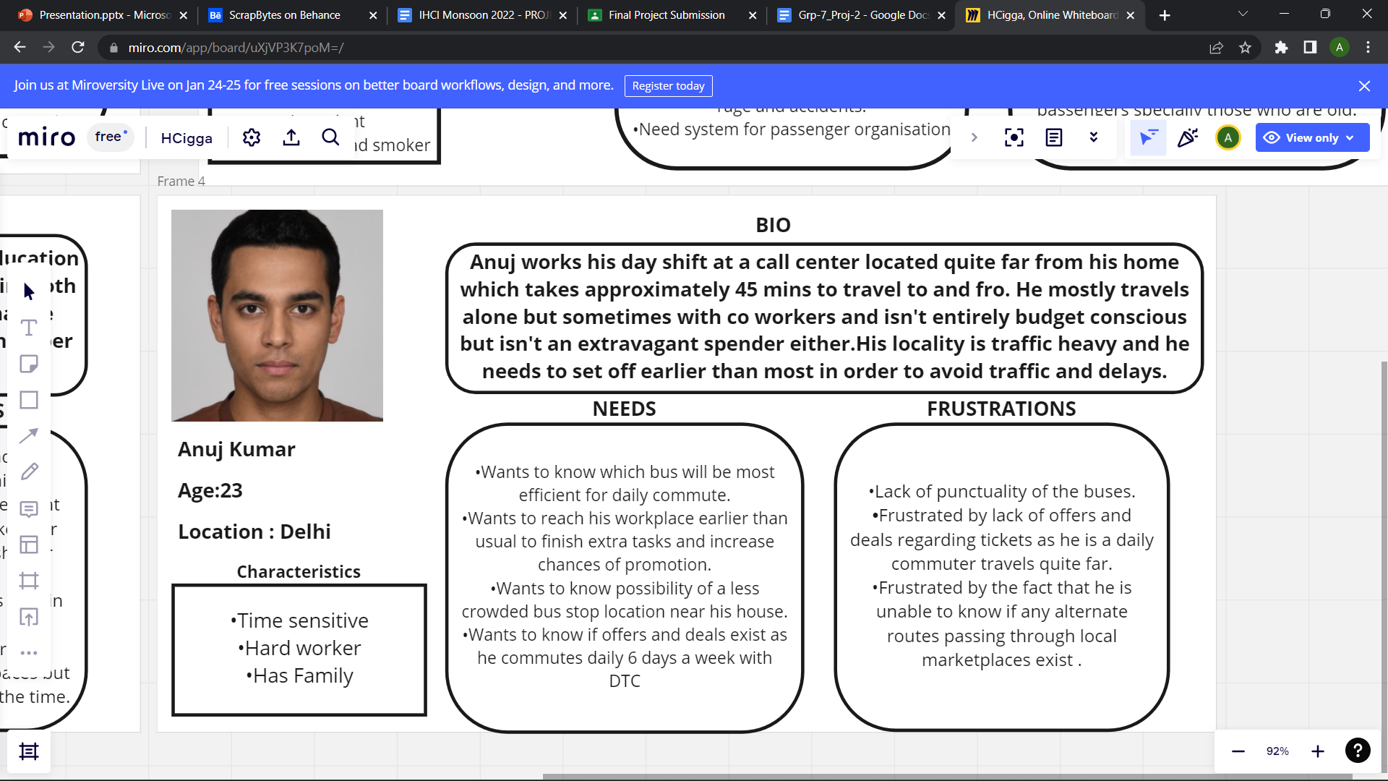

Slide 12
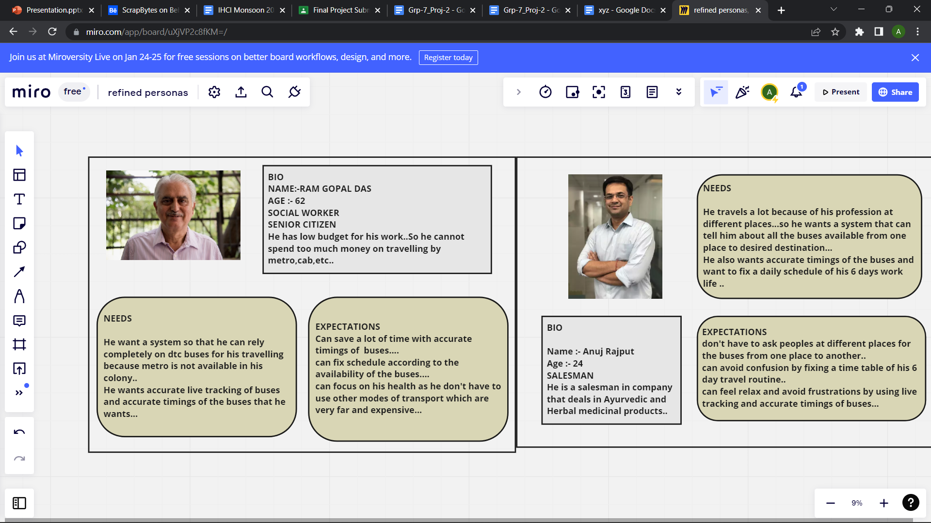

Slide 14
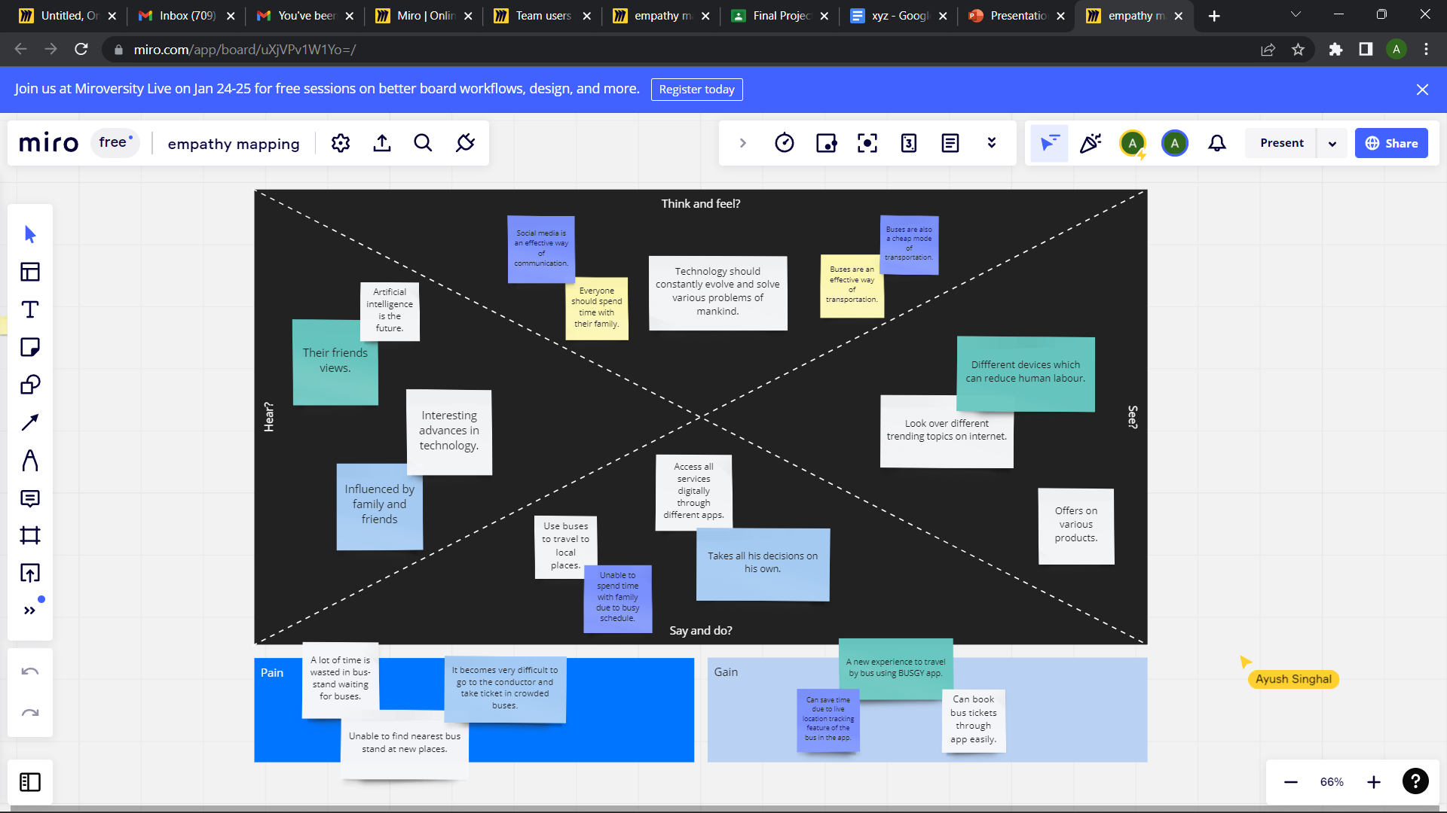
EMPATHY MAPPING
LINK FOR EMPATHYMAPPING

Slide 15

PROBLEM UNDERSTANDING

Slide 16
This app would help users to check the timing of upcoming buses, find the right bus numbers to travel to a particular destination as well as be able to book tickets online through an integrated payments gateway. This app will provide users the facility to use their live location to track the nearest bus stands. All the buses will have GPS installed in them due to which the app will be able to show the accurate timings of the upcoming buses using their live locations. Users wouldn’t have to gather around the conductors for tickets because the app would provide the facility of purchasing tickets online using an UPI-based payment gateway.
PROPOSED SOLUTION

Slide 17
TARGET USERS
1. Students are a big user base for our application. Everyday around lakhs of students use DTC buses to travel to their school and colleges.
2. People who have to go to their offices for work everyday are also a big user base of our application.
3. Women are also a big user base of our application. Since the DTC buses in Delhi are free for women, they usually prefer to travel by buses.
4. Senior citizens can also are great users of our application. Since the senior citizens face difficulty in crowded buses in getting tickets from the conductor, using this app they can easily book their tickets online.
5. Many tourists who come from other states to visit Delhi don’t know much about the buses in Delhi. Using this app, they could easily reach their desired location by buses at a nominal fare.

Slide 18
REQUIREMENTS IT WOULD FULFIL
1. It would show the accurate timing of the upcoming buses using live locations. It will provide them the accurate time at which they should reach the bus stop to board the bus.
2. It would help users to book their tickets through online mode, hence the users don’t need to go to the conductor to buy tickets thus solving the problem of crowd.
3. It would provide the users the shortest route to their destination and buses going in that route. Hence, the users can board those buses and save their time.
4. This app will also show the location of the nearest bus stand to the user. Hence, if the user doesn't know the location of the bus stand, he can easily reach the bus stop using the app.

Slide 19
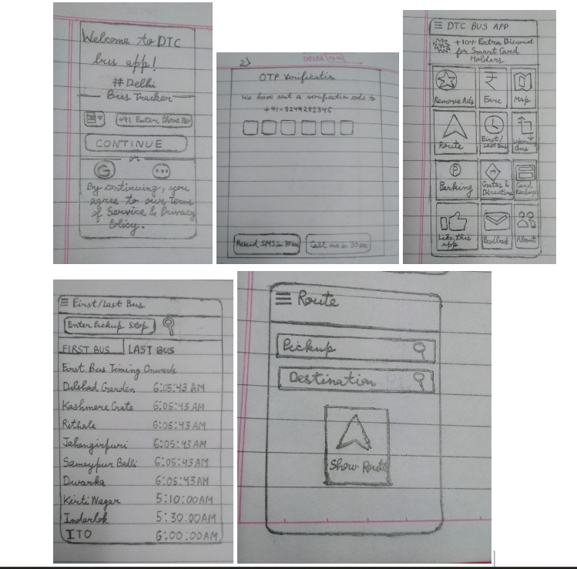
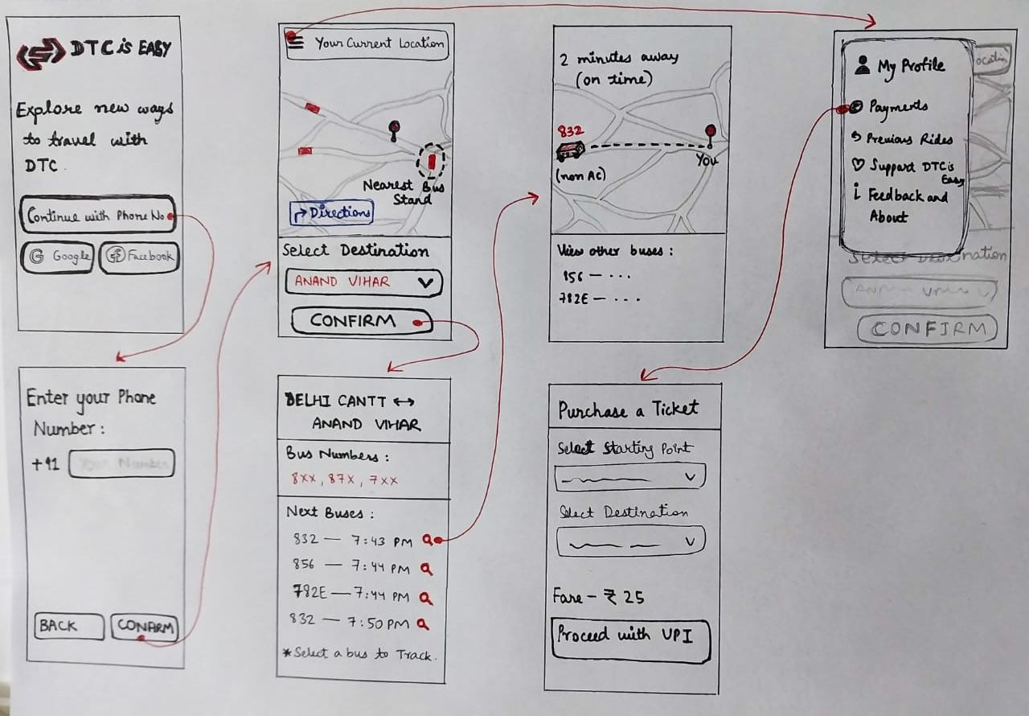
MAKING A LOFI PROTOTYPE

Slide 20
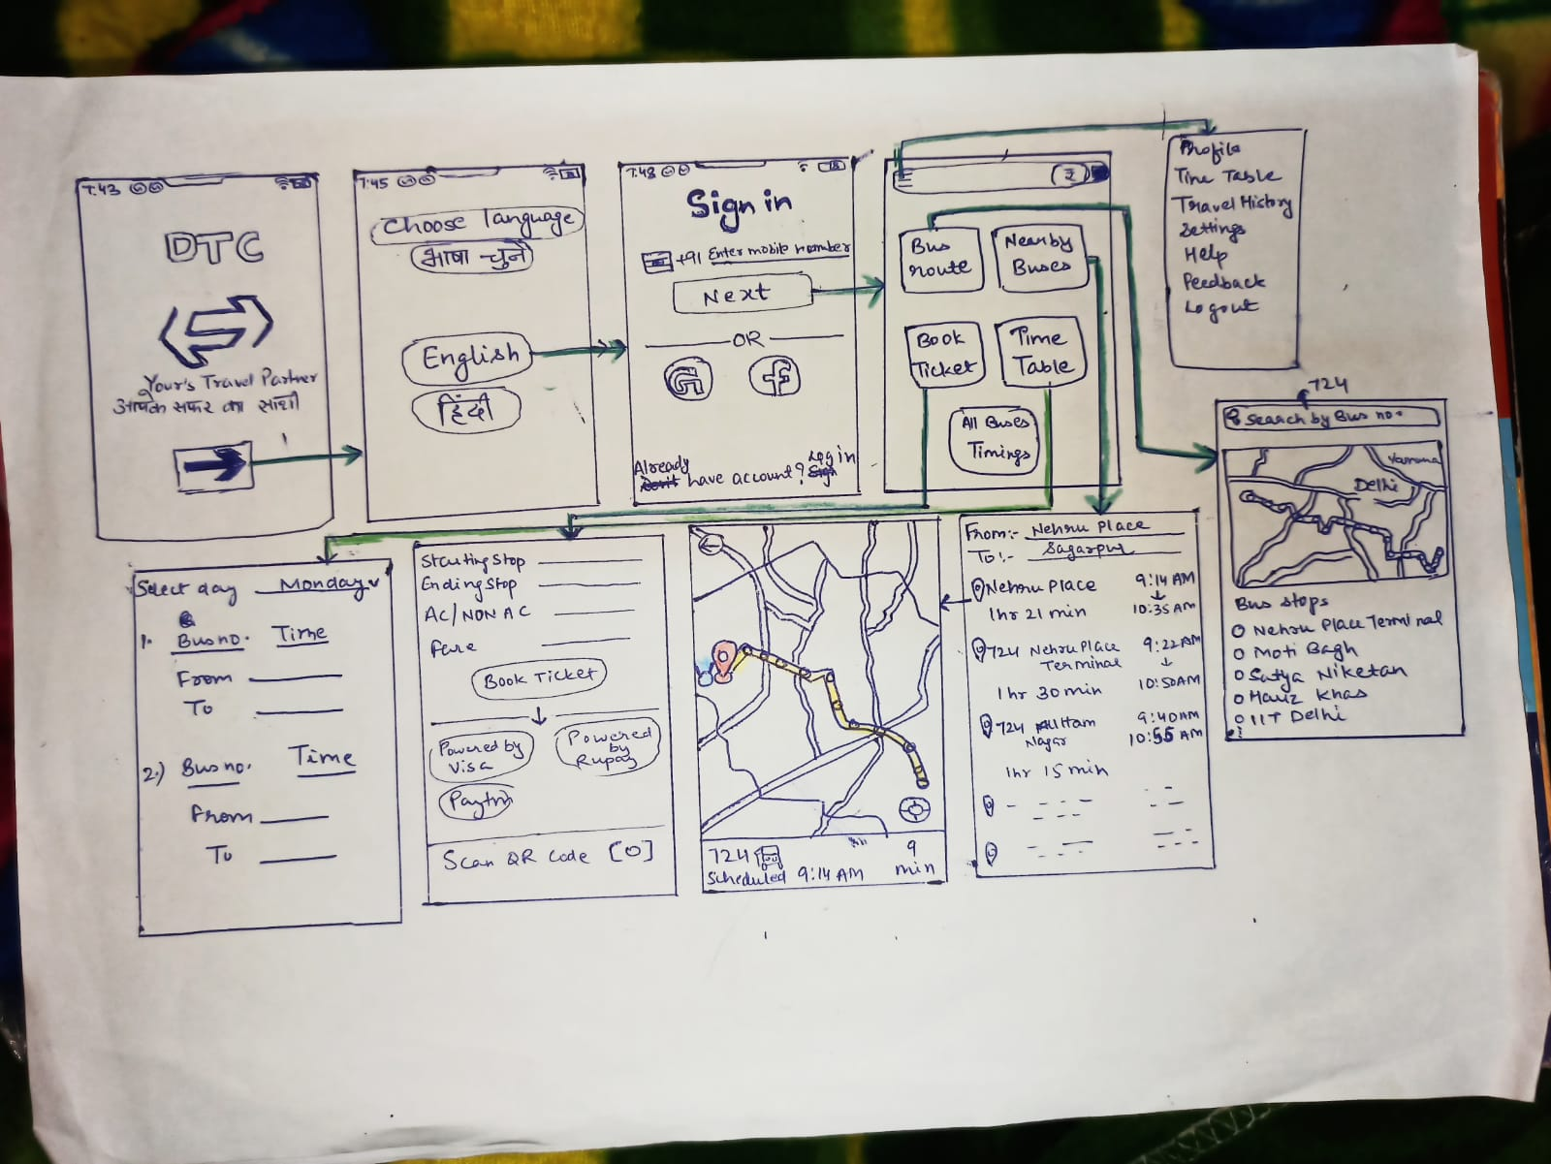
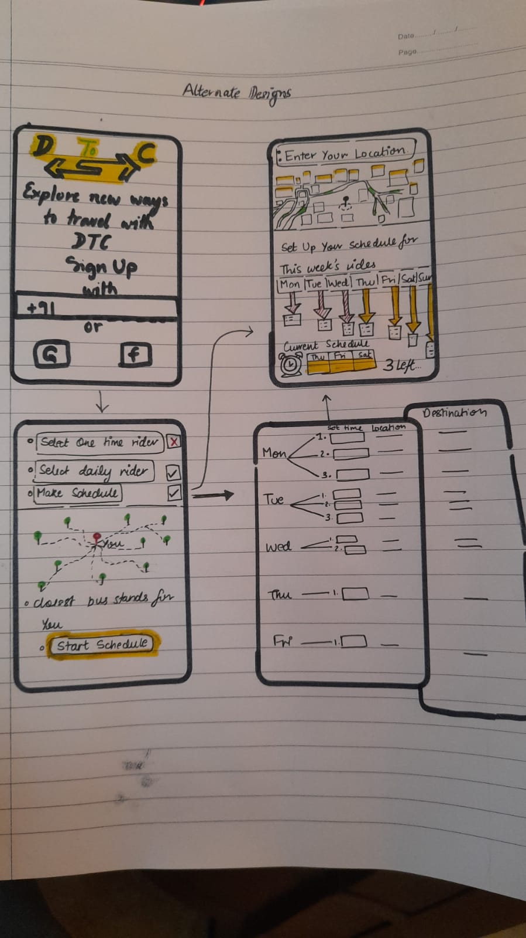
MAKING A LOFI PROTOTYPE

Slide 21
USER TESTING AND EVALUATION FOR LOFI'S
We conducted survey on google forms and interviews for our lofi user testing....
link of google form for lofi user testing.
link of interviews conducted
Based on those suveys and interviews we evaluated the following results :-
i) One observation was that the live tracking of buses displayed by our app should be accurate otherwise it would create unnecessary irritation to the users.
ii) We also need to create an interface in our app which would track the live location of the user and show them the location of the nearest bus-stop

Slide 22
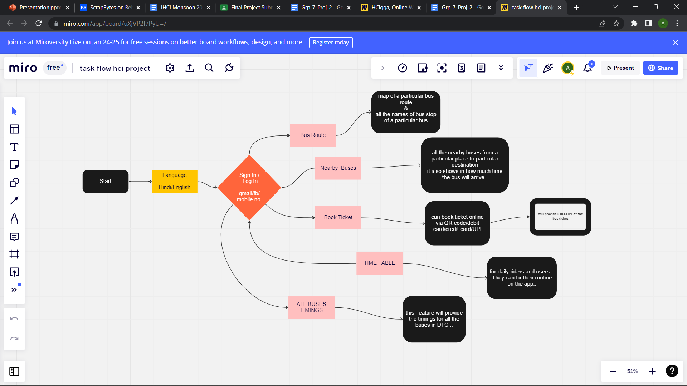
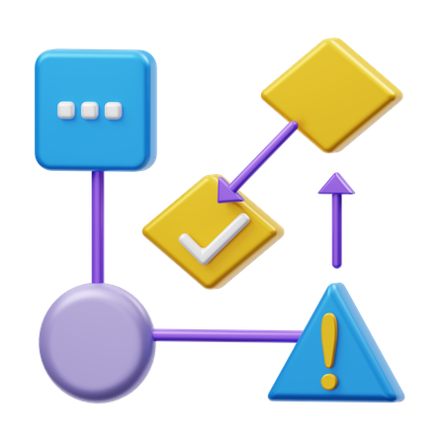
TASK FLOW
Link to task flow

Slide 23
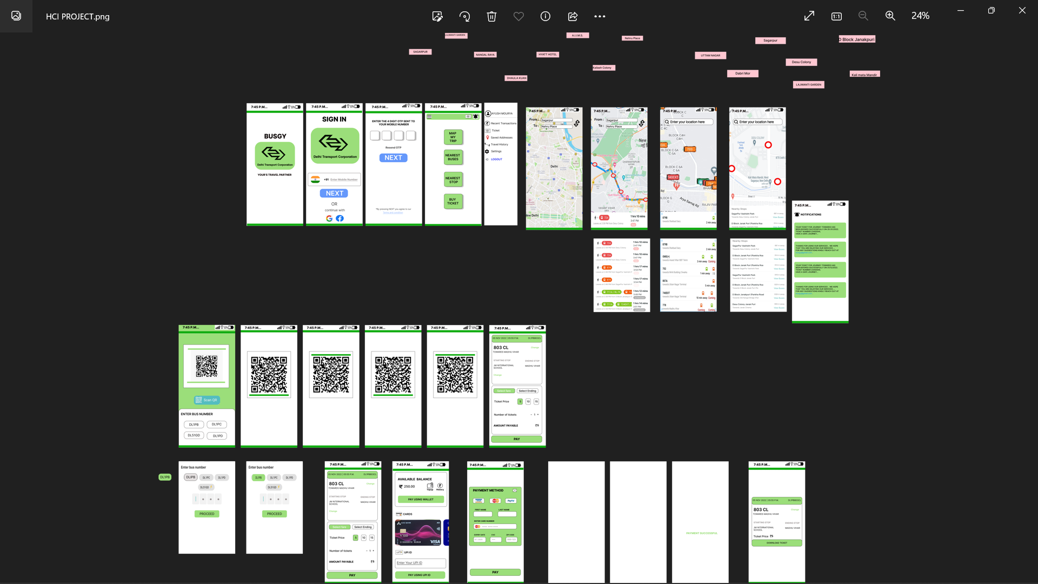
HIFI PROTOTYPE
link for figma hifi prototype

Slide 24
We conducted a survey for our hifi prototype :- link of google form Based on the surveys, our observations are:
i) We have to add an interface to allow users to buy ticket through cards.
ii) We can also make navigation between different interfaces easier by introducing some sub-menus under a main menu.
iii) We also have to add an interface to show the receipt of the ticket.
iv) We have to add an icon for showing notifications like the history of booking tickets.

Slide 25

LEARNINGS AND REFLECTIONS

Slide 26
Based upon our survey and the problems identified by the users :- 1.) We provided the notification icon that will show the messages that your ticket has been booked on a particular date. 2.) We provided an interface that will show the receipt of previous tickets bought. 3.) We provided the option of payment through cards that we didn't provided in the beginning of our project. 4.) We also worked on an interface that will provide the user to download e-ticket after they have successfully made the payment.

Slide 27
During the making of our app we come across various moments where we have a learnt a lot about developing the app which can be as follows:
5. It is very important for the developer to involve the user from the start of development of the app.
6. It is very important for the developers to know the exact user expectation as well as users requirements.
7. While making prototypes we need to be simple and easy to use so that our users don’t face difficulty in using the apps and can learn how to use it easily.
8. The making of hi-fi is really the most important part of the development as it is the soul of our app and hence we should make it keeping in mind the users perspective.

Slide 28
9. During the whole process we came to a conclusion that users play a very important role as the app is for the users to make their life easy
10. This app would make the life of daily bus users very peaceful as they can plan their whole journey.
11. This app would tell the users when and which bus they need to reach their destination in minimum time.
12. This app can help the users who are old to buy tickets as well as pass for whole month.
13. All in all this app can be the messiah to most of the people and can change their hard life to peaceful life.

